Slide 1
Organic Growth
Interactive peer discussion on optimizing your business for the long term
Month DD, YYYY
Speaker Name
Speaker Title
Speaker Name
Speaker Title
Speaker Name
Speaker Title
1174561.1.0

Slide 2
Recap: Exploring levers of growth
A framework
THINGS YOU
CAN’T CONTROL
THINGS YOU
CAN INFLUENCE
THINGS YOU
CAN CONTROL
MACRO ENVIRONMENT
WEALTH MANAGEMENT
ECOSYSTEM
FIRMS & ADVISORS
Market
appreciation
M&A
Recruiting
Organic
growth
1174561.1.0

Slide 3

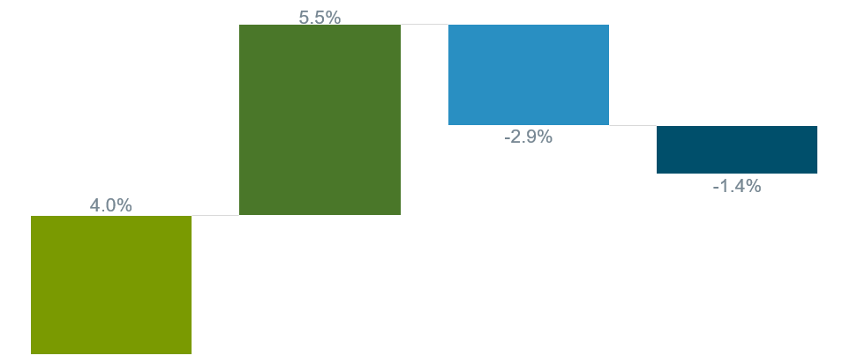
What is organic growth?
Withdrawals
from exiting clients
Withdrawals
from departing clients
New assets from new clients
5.2%
Organic Growth
New assets from existing clients
*Fidelity client growth rates (2024)
Source: 2024 Fidelity RIA Benchmarking Study
1174561.1.0

Slide 4
Why organic growth matters
Potential benefits
from organic growth
Potential challenges
from the lack of organic growth
Enterprise value
Attracting & retaining talent
Risk diversification
Purchasing power
Marketplace disintermediation
Firm culture & morale
Firm financials
Brand image
"Organic growth has the largest impact on firm valuation."
John Furey, Managing Partner, Advisor Growth Strategies
1174561.1.0

Slide 5

External growth drivers
Clients’ needs and their product needs have evolved
Client
Women investors
Solo households
Next gen investors
.
Life events
i.e. divorcees
Unretirees
Products & services
B
Digital assets
Alternative investments
Tax & estate planning
Health
Safety & security
Source: McKinsey & Company, 2023 Fidelity Investor Insights Study
1174561.1.0

Slide 6
Internal growth drivers
Growth Mindset, Outsourcing, Associate Alignment
Goals, Tools, Capacity, Data, Capabilities
Ideal Client Profile, Value Prop, Case Studies
FOUNDATIONAL READINESS ACROSS PEOPLE | PLATFORM | CLIENT | OFFERING
1174561.1.0

Slide 7





Exploring opportunities for organic growth
A framework
Uncover more prospects
Expand client relationships
Scale your business
Discover how to implement effective lead generation strategies by leveraging COIs, asking for client referrals, and building business development processes.
Build client relationships to increase share of wallet, optimize client onboarding, and deepen client engagement.
Enhance business efﬁciency to spend time where it matters most, and learn how to segment your clients to improve client proﬁtability.
1174561.1.0

Slide 8
Uncover more prospects
A part of the Organic Growth framework
8
1174561.1.0

Slide 9

Client acquisition is an omni channel game
Social Media
Networking
Website/ Newsletters/ Podcasts
Larger firms tend to leverage PR, online events, online advertising and in-person events more frequently than smaller firms.
Content Marketing
Webinars
Traditional/ Online Advertising
Events
Referrals
COIs
Source: 2024 Fidelity RIA Benchmarking Study. Larger firms refers to those with AUM of $1 billion or more.
1174561.1.0

Slide 10

Networking
1
Be intentional: Why and whom do you want to meet?
2
Follow-up is the secret sauce: Connect, remember the small stuff
3
Aim to make friends, not just connections: 360° network and 3Is
4
Create your own
1174561.1.0

Slide 11
Grow your business through client referrals
Build a referral pipeline by creating an exceptional client experience, not by making an ask.
Some circumstances that led to client referrals
11%
Advisor asked for referral
Build the relationship
30%
Friend described a financial challenge
Communicate your value
Ask for feedback
46%
Friend asked for a recommendation
Source: 2023 Fidelity Investor Insights Study
1174561.1.0

Slide 12

Identify your potential COIs
Assess fit based on your service offering
Reciprocity
●
Diversity of services
●
●
Regulatory impact
Target
COIs
Geography
●
●
Target market
●
Risk
1174561.1.0

Slide 13
Table discussion questions
1 | What is your biggest prospecting challenge?
2 | What has been the most productive prospecting tactic for you?
3 | If you had your desired budget to build an omni-channel prospecting strategy, how would you do it?
1
2
3
1174561.1.0

Slide 14
Expand client relationships
A part of the Organic Growth framework
14
1174561.1.0

Slide 15
Deepen relationships with your existing clients with a more personalized approach
Nearly two-thirds of Gen YZ investors and half of Gen X investors seek services beyond money management and advice.
Where investors get the most value from a financial advisor:
Peace of mind
61%
Gen YZ
Financial planning
51%
Gen X
Source: 2024 Fidelity Investor Insights Study
* Generations defined: Boomers+ (born 1928-1964), Gen X (born 1965-1980), Gen Y (1981-1996), and Gen Z (born 1997-2012)
1174561.1.0

Slide 16
Competition to differentiate service offering is intensifying
DIFFERENTIATED
COMPETITIVE
TABLESTAKES
Concierge services
Trust services
Life planning/coaching services
Tax preparation
Health & wellness/HSA
Estate planning
% of RIAs Planning to Add Service
Philanthropic planning
Risk/insurance planning
Third-party lending product evaluation
Retirement plan servicing
Tax planning & strategy
Cash management & budgeting
Investment management
Financial planning
% of RIAs Currently Offering Service
Source: 2024 Fidelity RIA Benchmarking Study
1174561.1.0

Slide 17
Broaden your investment capabilities
of investors with advisors are interested in personalized products
Investment options
82%
Alternatives
Active ETFs
Direct Indexing
of the combined Gen YZ cohort believe that “Aligning my investments to my values” is more important than getting maximum returns on my investments
Thematic funds
Digital assets
Custom model portfolios
55%
Source: 2024 Fidelity Investor Insights Study
1174561.1.0

Slide 18
Table discussion questions
1 | What have you done to your service offering that has driven deeper client engagement?
2 | What have you done to broaden your investment options?
3
1
2
3
  What challenges do you have when building relationships (and expanding share of wallet) with existing clients and their families?
1174561.1.0

Slide 19
Scale & optimize your business
A part of the Organic Growth framework
19
1174561.1.0

Slide 20
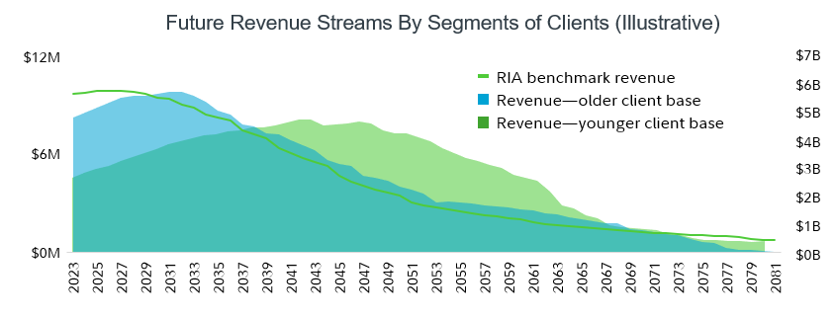
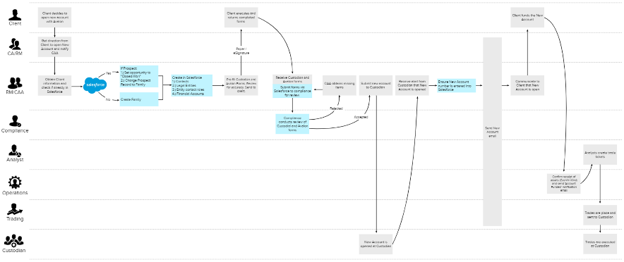

Scale & optimize
Scale: Technology & Process
Optimize: Segmentation & Outsourcing
3-year revenue CAGR growth rates for tech embracers vs others¹
Segmentation
2
Process workflow
Outsourcing
9.1 Hours
Saved per week on investment management outsourcing³
Sources: ¹2024 Fidelity RIA Benchmarking Study
²Fidelity Client Insight Tool. Data collected from 2019 to June 2023
The information contained in, and the data generated by the Client Insight Tool are hypothetical in nature, for informational purposes only, and may not reflect your (or your client's) particular situation. Please see Important Information section for details and more complete information.
³2023 Fidelity Financial Advisor Community – Investment approach and product survey
1174561.1.0

Slide 21
Gain traction with GrowthTech
Automate how you execute, optimize and track business development initiatives, deepen client relationships and capture 360-degree customer data for actionable insights​
Firm tech stack
CMS: Websites, Blog, Content
Modeling
Rebalancing
Brand/Reputation Management.
Portfolio
Reporting
Email Marketing
Productivity & Sales Enablement
Growth
Tech
Document
Management
Client
Portal
CRM
or CDP
Social Media Marketing, Ad Management
Emerging Channels:
Generative AI, text, digital PR, voice, chat, hybrid events
Financial
Planning
Data &
Analytics
Predictive Analytics, A/B Testing, Lead Enrichment & Scoring
SEO-Search
Content Marketing (Creation/Curation)
1174561.1.0

Slide 22
Table discussion questions
1 | How do you think about efficiency at your firm (are you thinking about segmentation, outsourcing, workflow, and talent)?
2 | How are you leveraging technology tools to spend more time where it matters most?
3
1
2
3
  What are your biggest challenges when it comes to scaling and optimizing your firm?
1174561.1.0

Slide 23
The Fidelity Growth HubSM
Access our dedicated advisory tool kit at:
i.fidelity.com/growthhub
No matter where you are on your growth journey, Fidelity can help guide you with our handpicked insights and how-to resources designed to help you deliver on your biggest business goals.
Prospect |  | Expand |  | Scale + Optimize
Implement effective lead generation strategies, create a high-impact sales process, and find and nurture prospective clients. |  | Build client relationships to increase share of wallet, optimize client onboarding, and deepen client engagement. |  | Optimize your model to spend time where it matters most, as well as learn how to segment your clients to improve profitability.
1174561.1.0

Slide 24
Important Information
The 2024 Fidelity RIA Benchmarking Study was conducted between February 5 and April 19, 2024; 310 firms participated. The study was conducted via an online survey, with the sample provided by Brookmark, a third-party firm not affiliated with Fidelity. Respondents were screened for a minimum level of $50K in investable assets (excluding retirement assets and primary residence), with additional quotas by age and affluence levels. The data included in this piece is from investors who self-identified as either “man” or “woman” for the purpose of helping us understand their needs, goals, and preferences. Gen Z: born 1997-2012; Gen Y: born 1981-96; Gen X: born 1965-80; Boomers: born 1946-64; Silent Generation: born 1928-45.
The 2024 Fidelity Investor Insights Study: The study was conducted November 7, 2023, through December 19, 2023. It surveyed a total of 2,100 investors, including 696 millionaires. The 2023 Fidelity Investor Insights Study was conducted between April 17 and July 4, 2023; 245 firms participated. It surveyed a total of 2,100 investors, including 696 millionaires. The study was conducted via an online survey with the sample provided by an independent firm not affiliated with Fidelity Investments. Respondents had to have at least $50K or more in total household investable assets (excluding employer-sponsored plan assets and primary residences), and to meet quotas by age and affluence. Respondents had sole or shared financial planning decision-making responsibility for household. Gen Y/Z includes those aged 21–42. Gen X includes those aged 43–58. Boomers+ includes those aged 59+. The results of the study are weighted to reflect the target populations of age and assets based on the Federal Reserve Survey of Consumer Finances (SCF).
The 2023 Fidelity Financial Advisor Community—Investment Approach & Product Survey was an online blind survey (Fidelity not identified) and was fielded during the period April 24 through May 1, 2023. Participants included 512 advisors who manage or advise upon client assets either individually or as a team, and work primarily with individual investors. Advisor firm types included a mix of banks, independent broker-dealers, insurance companies, regional broker-dealers, RIAs, and national brokerage firms (commonly referred to as wirehouses), with findings weighted to reflect industry composition. The study was conducted by an independent firm not affiliated with Fidelity Investments.
Fidelity Client Insight Tool is a client engagement and aggregation of 90+ firms and over 125K lines of data presented by households. Data was collected from 2019 to June 2023 by the Fidelity Practice Management & Consulting team. The Client Insight Tool should not be construed as advice of any kind. The information contained in, and the data generated are hypothetical in nature, for informational purposes only, and may not reflect your particular situation. The projections are based on assumptions described herein. Fidelity does not confirm the accuracy of the data in this example. You should conduct your own analysis, review, and due diligence based on your specific actions. You are responsible for evaluating your own practice and making appropriate decisions for your firm. Those decisions may be based on these and other factors you deem relevant. This example is not meant to be exhaustive of all possible options you may consider. Fidelity is not responsible for your action or inaction as a results of this service. The data used to generate these illustrations and the illustrations themselves are intended to provide you with a general idea of what you may expect in each future scenario. The reports use data provided by third-party vendors in the situations and the accuracy and timeliness of that data cannot be guaranteed. Results may vary with each use and over time.
24
1174561.1.0

Slide 25
Information provided in, and presentation of, this document are for informational and educational purposes only and are not a recommendation to take any particular action, or any action at all, nor an offer or solicitation to buy or sell any securities or services presented. It is not investment advice. Fidelity does not provide legal or tax advice.
Before making any investment decisions, you should consult with your own professional advisers and take into account all of the particular facts and circumstances of your individual situation. Fidelity and its representatives may have a conflict of interest in the products or services mentioned in these materials because they have a financial interest in them, and receive compensation, directly or indirectly, in connection with the management, distribution, and /or servicing of these products or services, including Fidelity funds, certain third-party funds and products, and certain investment services.
Third-party trademarks and service marks are the property of their respective owners. All other trademarks and service marks are the property of FMR LLC or its affiliated companies.
Fidelity Investments® provides investment products through Fidelity Distributors Company LLC; clearing, custody, or other brokerage services through National Financial Services LLC or Fidelity Brokerage Services LLC, Members NYSE, SIPC; and institutional advisory services through Fidelity Institutional Wealth Adviser LLC.
© 2024 FMR LLC. All rights reserved.
1174561.1.0
1.9918730.100
25
1174561.1.0

